Slide 1
The Process of Requirement Usecase Modeling
Md. Mohaiminul Islam
Lecturer, CSE
University of Asia Pacific

Slide 2
The Process of Requirements Use‐Case Modeling
Objective is to elicit and analyze enough requirements information to prepare a model that:
Communicates what is required from a user perspective.
Is free of specific details about how the system will be built or implemented.
Steps
Identify business actors.
Identify business use cases.
Construct use‐case model diagram.
Document business requirements via use‐case narratives.

Slide 3
Step 1: identify Business Actors
When looking for actors, ask the following questions:
Who or what provides inputs to the system?
Who or what receives outputs from the system?
Are interfaces required to other systems?
Are there events that are automatically triggered at a predetermined time?
Who will maintain information in the system?

Slide 4
Step 2: Identify Business Requirements Use Cases
During requirements analysis, strive to identify and document only the most critical, complex, and important use cases, often called essential use cases.
When looking for use cases, ask the following questions:
What are the main tasks of the actor?
What information does the actor need from the system?
What information does the actor provide to the system?
Does the system need to inform the actor of any changes or events that have occurred?
Does the actor need to inform the system of any changes or events that have occurred?

Slide 5
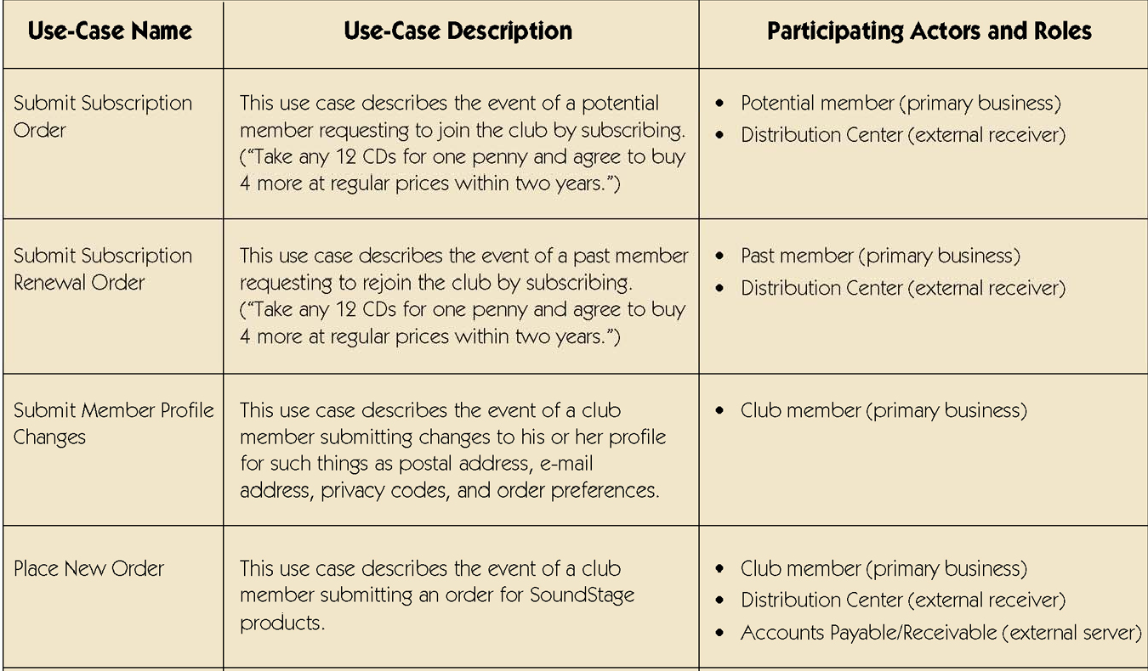
Sample Use‐Case Glossary

Slide 6
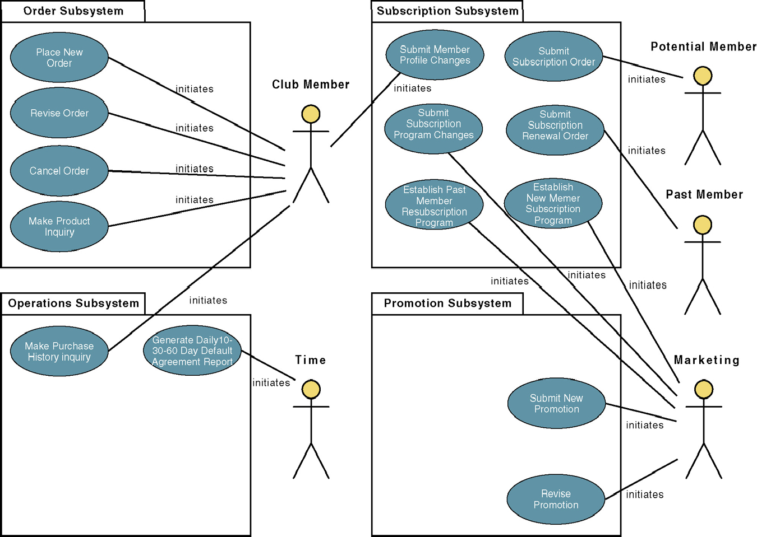
Step 3: Construct Use‐Case Model
Diagram

Slide 7
Step 4: Document Business Requirements Use‐Case Narratives
Document first at high level to quickly obtain an understanding of the events and magnitude of the system.
Then expand to a fully‐documented business requirement narrative.
– Include the use case’s typical course of events and its alternate courses.

Slide 8
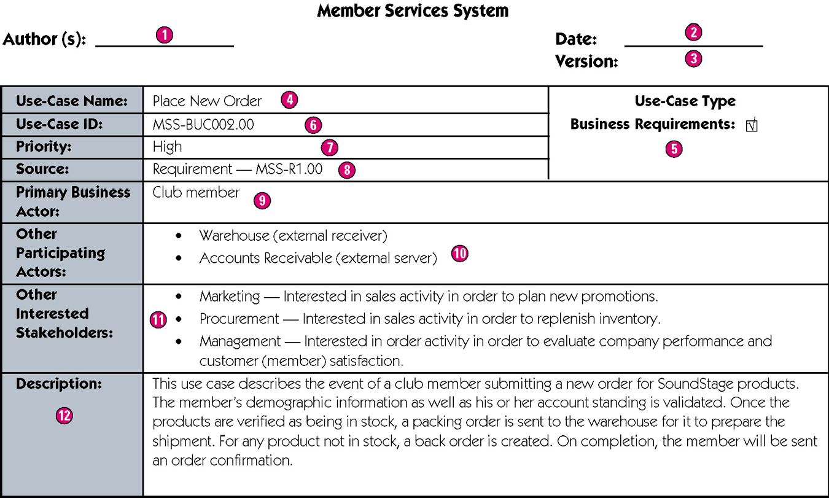
Sample High‐Level Version of a Usecase
Case Narrative

Slide 9
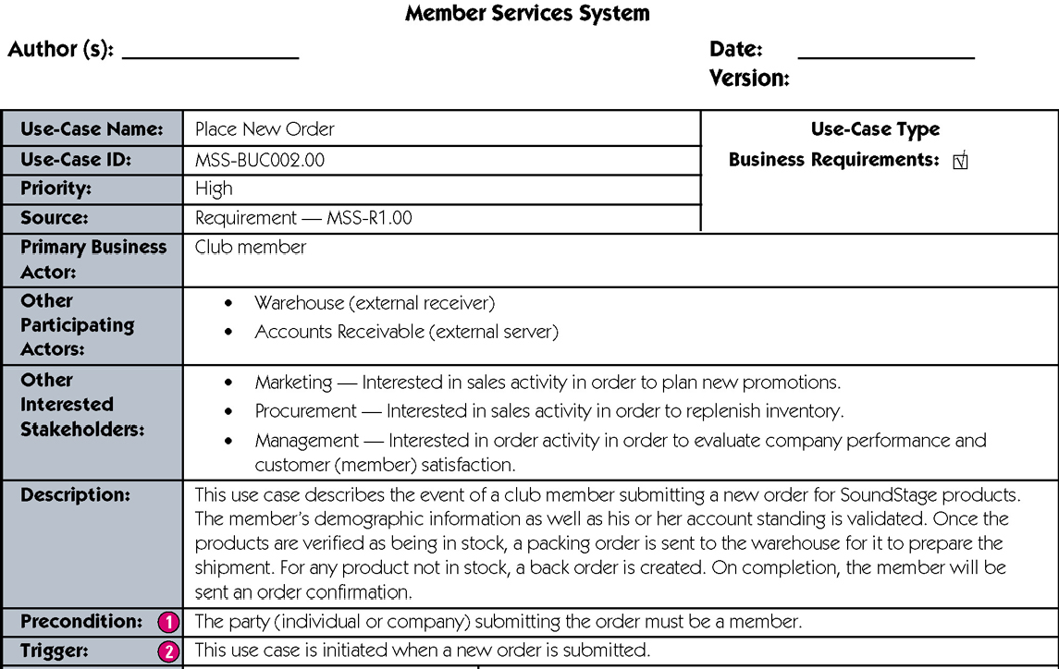
Sample Expanded Version of a Usecase
Case Narrative

Slide 10
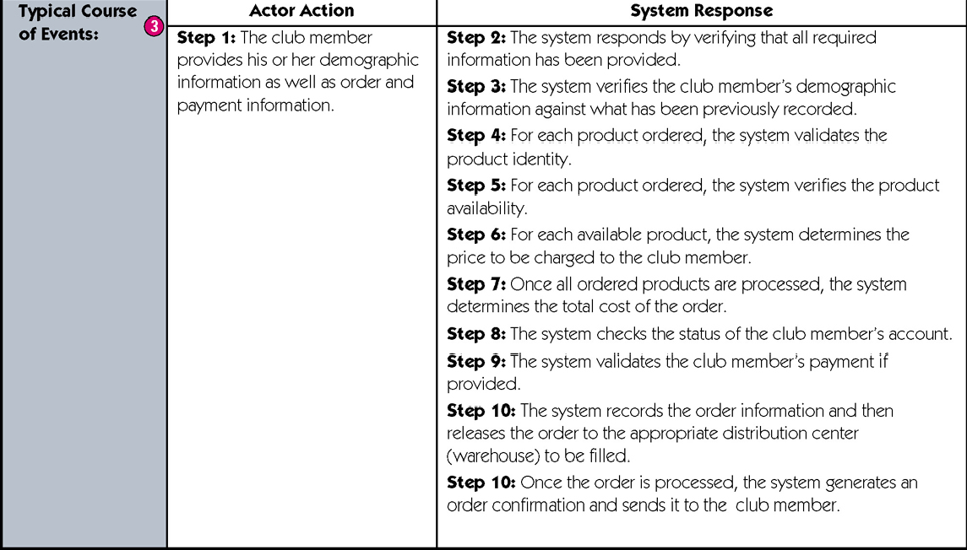
Sample Expanded Version of a Usecase

Slide 11
Use Case Description
:Each use case may include all or part of the following
▪ | Title or Reference Name | - meaningful name of the UC
▪ | Author/Date | - the author and creation date
▪ | Modification/Date | - last modification and its date
▪ | Purpose | - specifies the goal to be achieved
▪ | Overview | - short description of the processes
▪ | Cross References | - requirements references
▪ | Actors | - agents participating
▪ | Pre Conditions | - must be true to allow execution
▪ | Post Conditions | - will be set when completes normally
▪ | Normal flow of events | - regular flow of activities
▪ | Alternative flow of events | - other flow of activities
▪ | Exceptional flow of events | - unusual situations
▪ | Implementation issues | - foreseen implementation problems

Slide 12
Example- Money Withdraw
•
•
•
•
•
Use Case: Withdraw Money Author: PKD
Date: 11-09-2013
Purpose: To withdraw some cash from user’s bank account
Overview: The use case starts when the customer inserts his card into the system. The system requests the user PIN. The system validates the PIN. If the validation succeeded, the customer can choose the withdraw operation else alternative 1 – validation failure is executed. The customer enters the amount of cash to withdraw. The system checks the amount of cash in the user account, its credit limit. If the withdraw amount in the range between the current amount + credit limit the system dispense the cash and prints a withdraw receipt, else alternative 2 – amount exceeded is executed.
Cross References: R1.1, R1.2, R7
•

Slide 13
Actors: Customer Pre Condition:
•
•
The ATM must be in a state ready to accept transactions
The ATM must have at least some cash on hand that it can dispense
The ATM must have enough paper to print a receipt for at least one transaction
Post Condition:
The current amount of cash in the user account is the amount before the withdraw minus the withdraw amount
A receipt was printed on the withdraw amount
The withdraw transaction was audit in the System log file
•

Slide 14
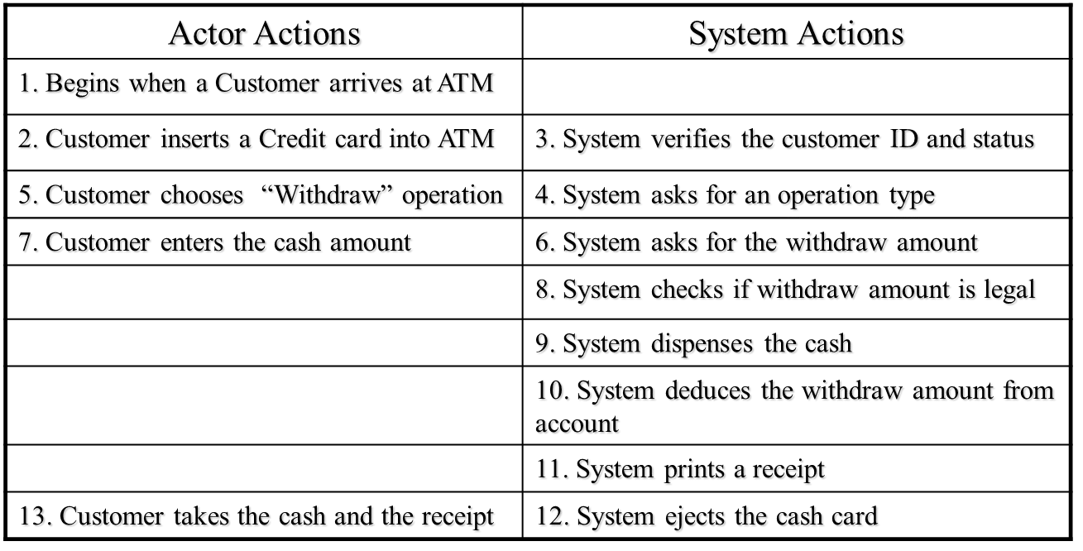
Typical course of events

Slide 15
Thank you

